Slide 1
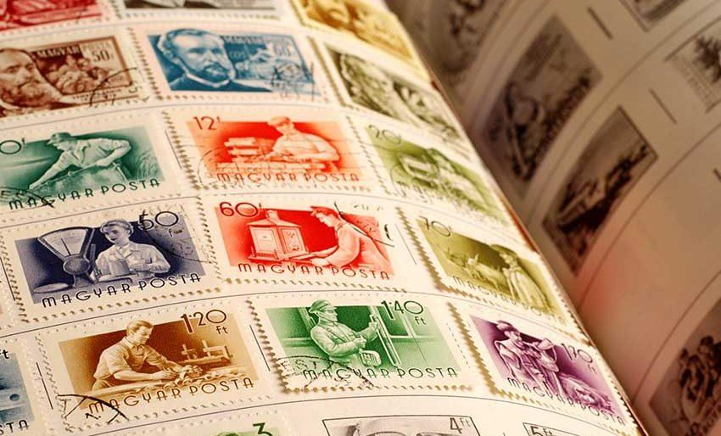
Stamp Hub
Universidade de Aveiro
Interação Humano-Computado
P5r João Miguel Matos
Mariana Gomes
Rafael Coelho

Slide 2

What is it and why?
Stamp Hub is a digital platform to manage a stamp collection online.
It allows the user to see their entire collection and manage it in very different ways.
Stamp collections can be huge, and managing them on paper can get overwhelming.
Our digital solution allows a better access and management of the collection.

Slide 3
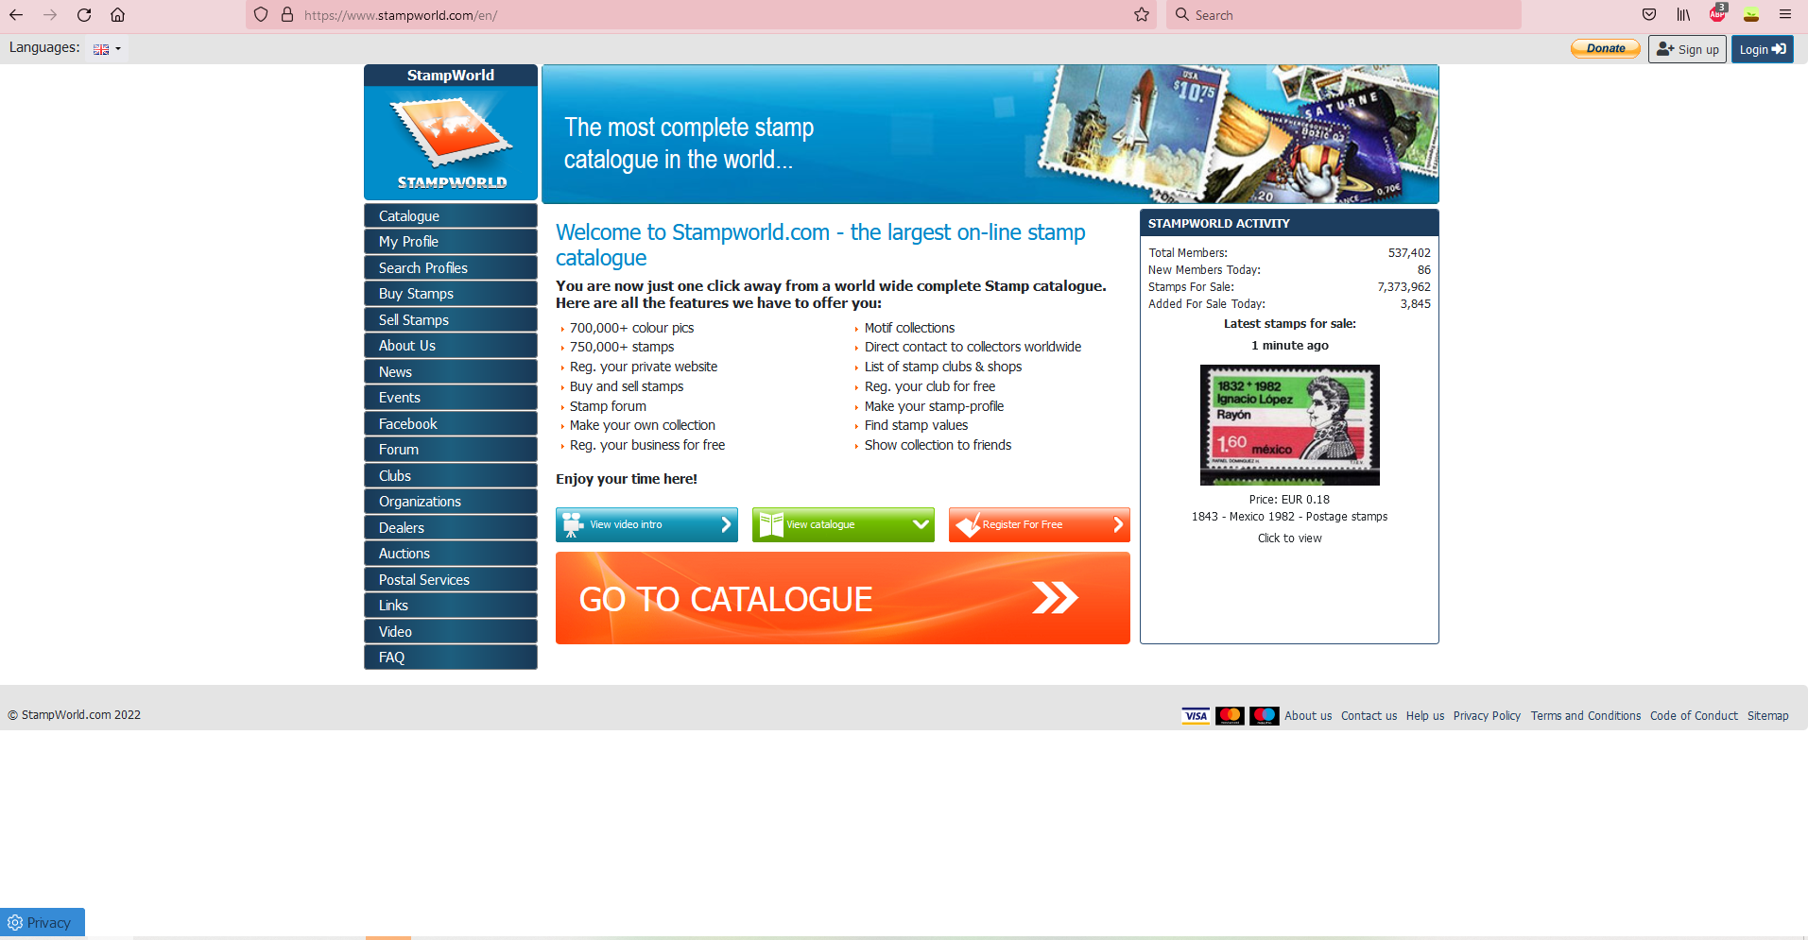
Is there anything like StampHub already?
Yes, there is already a online platform with the same purpose as StampHub, Stampworld. But its interface is outdated and complicated.

Slide 4

Requirement Analysis
Persona
Luís Pereira​
25-35 years old​
Stamp Collector​
​
Collection size is spiraling out of control, and thus needs a mean to organize and track everything.

Slide 5



Requirement Analysis
Tasks
Create a tag and use it to mark a stamp
Add a new stamp
Edit a stamp

Slide 6
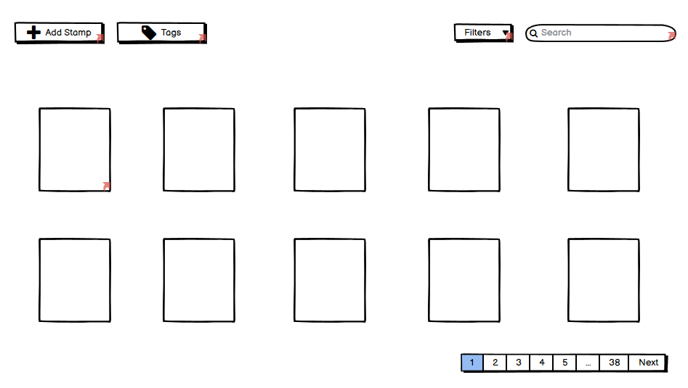
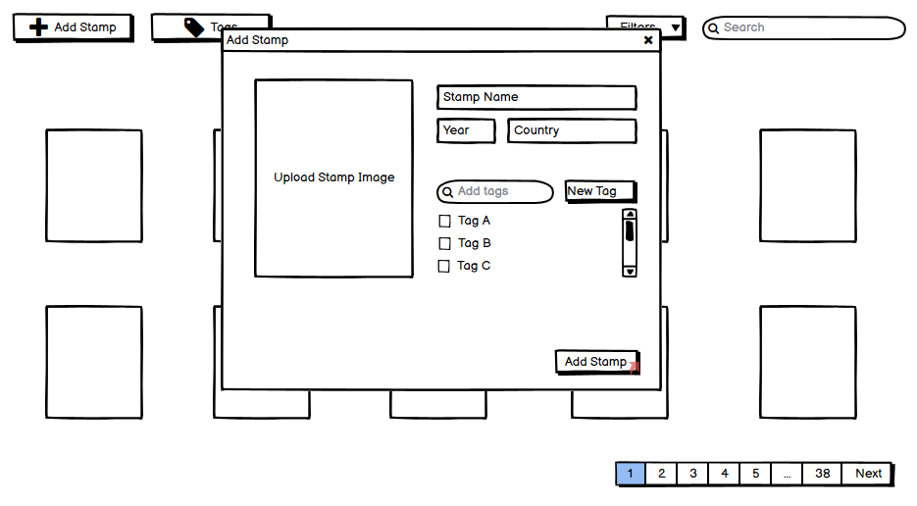
Low Fidelity Prototype

Slide 7
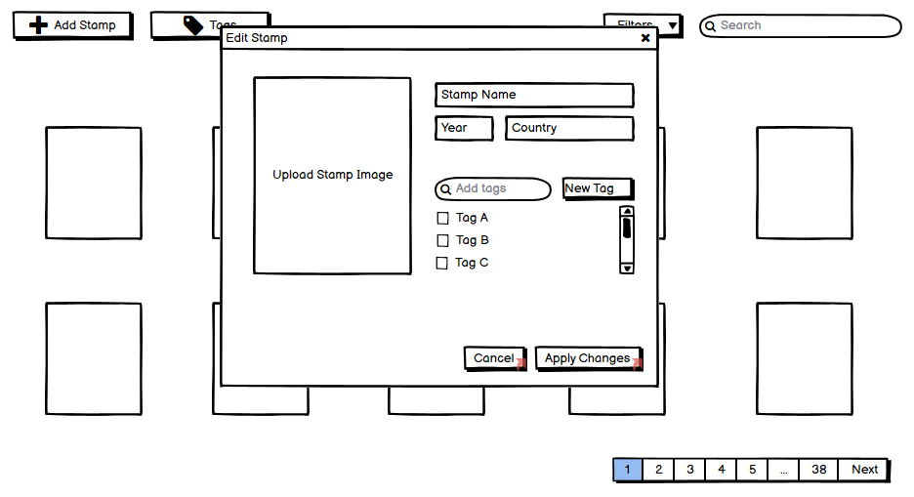
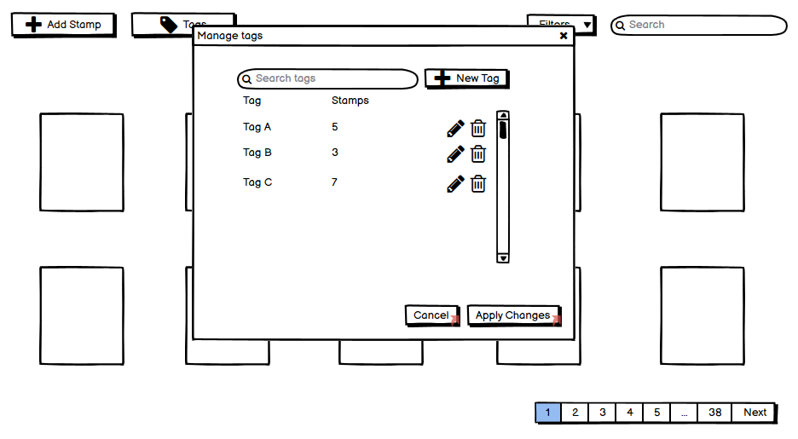
Low Fidelity Prototype

Slide 8
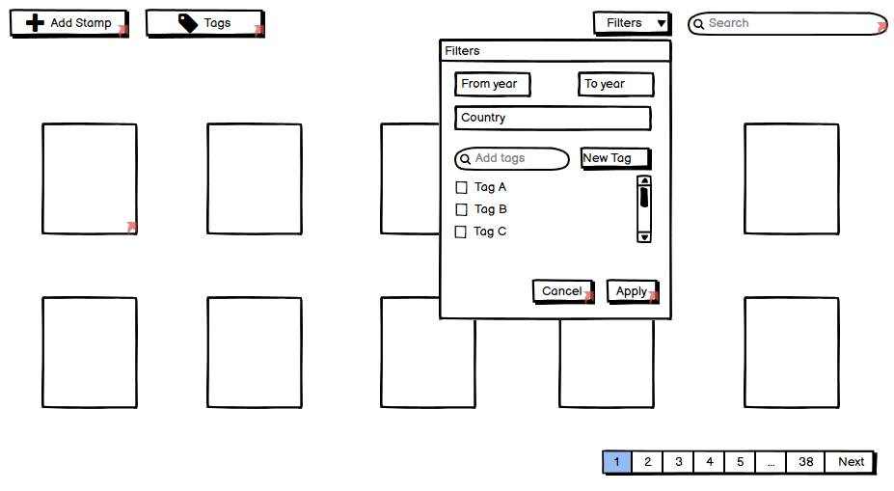
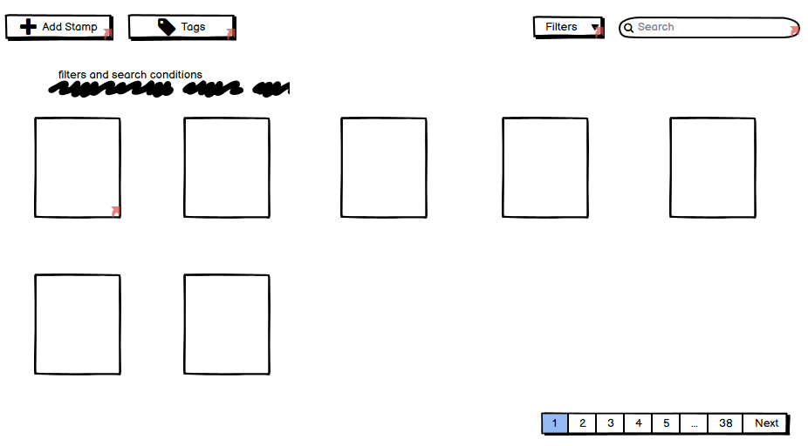
Low Fidelity Prototype

Slide 9
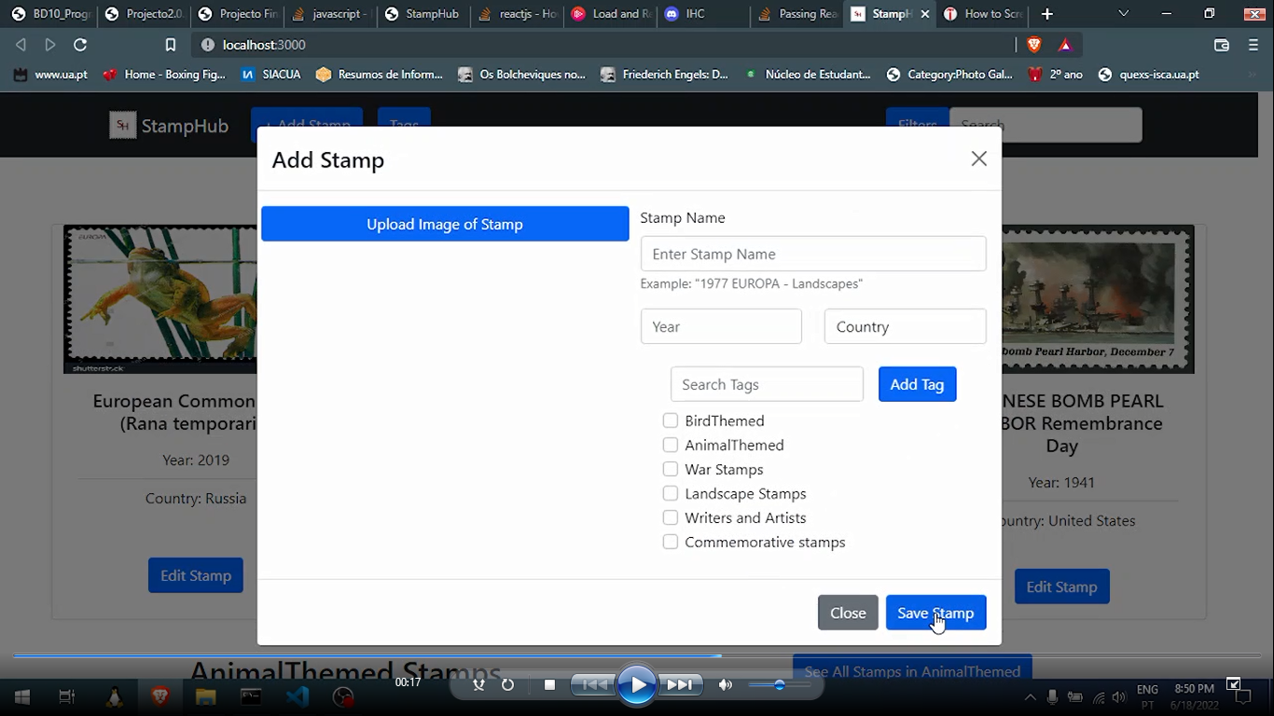
The Next Step
After the prototype was done we started building the site with React

Slide 10

Usability Test
Once our platform was built we asked a total of 10 people what they thought of it. 7 of those are in this class.
We asked them to do the following tasks:
Edit a stamp.
Create a new tag for categorize the stamp collection
Add a new stamp collection

Slide 11
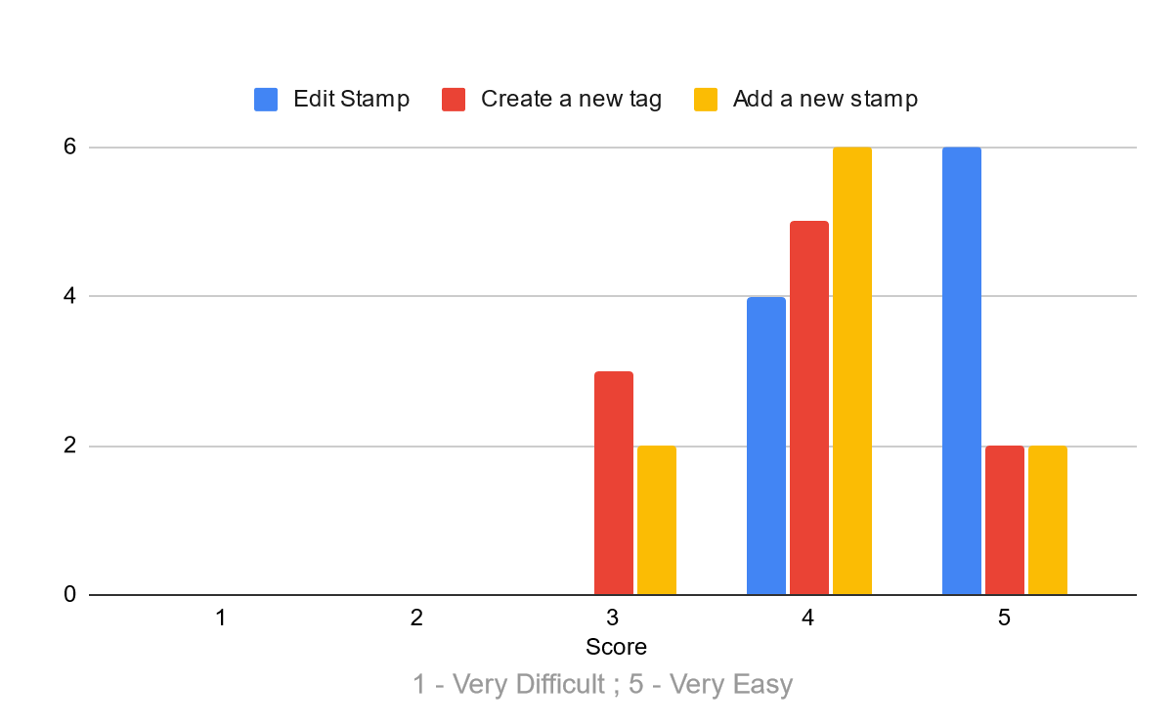
Usability Test

Slide 12
Post Task Questionnaire
We asked the people who performed those task to give a score to the following sentences.
I think I would use this system frequently
I thought the system was hard to use
I think that I wouldn’t need the support of a technical person to be able to use this system
I found the various functions in this system were poorly integrated
I thought there was too much inconsistency in this system
I would imagine that most people would learn to use this system very quickly

Slide 13
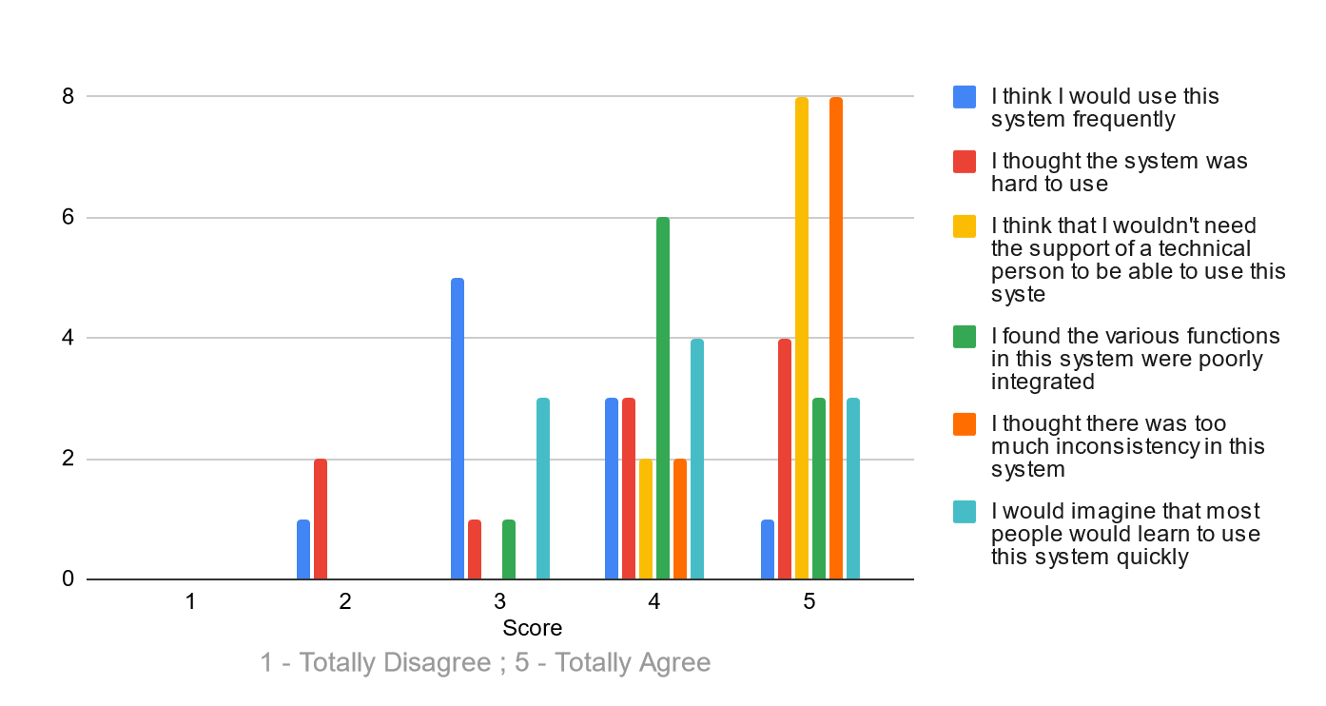
Post Task Questionnaire

Slide 14
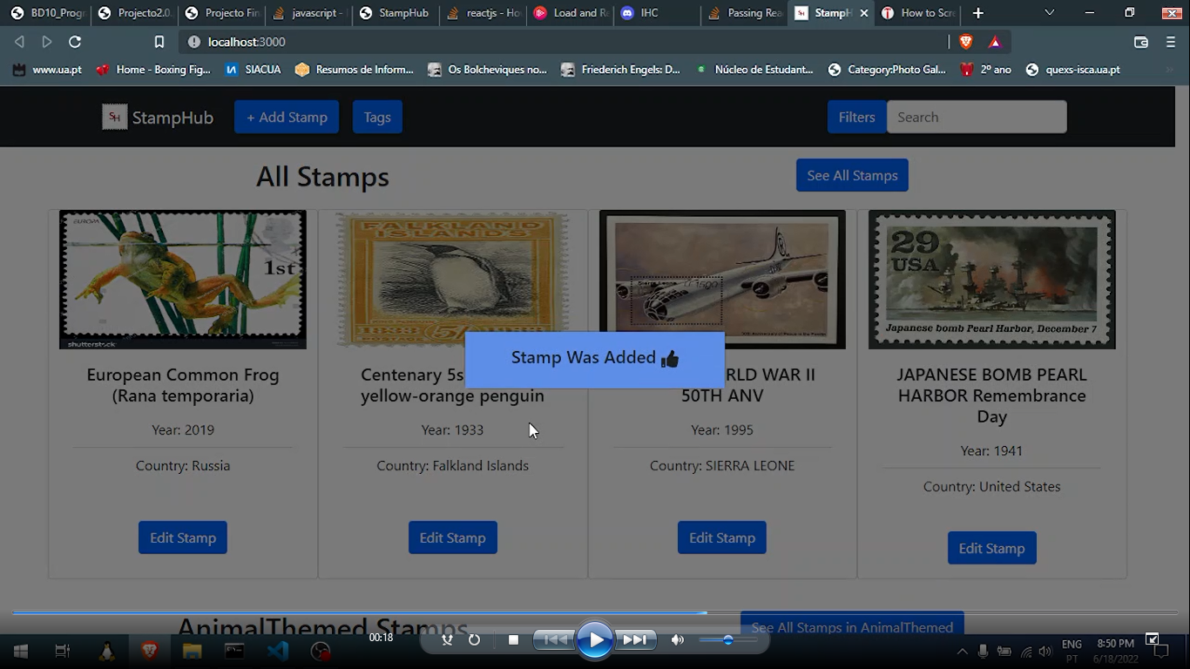
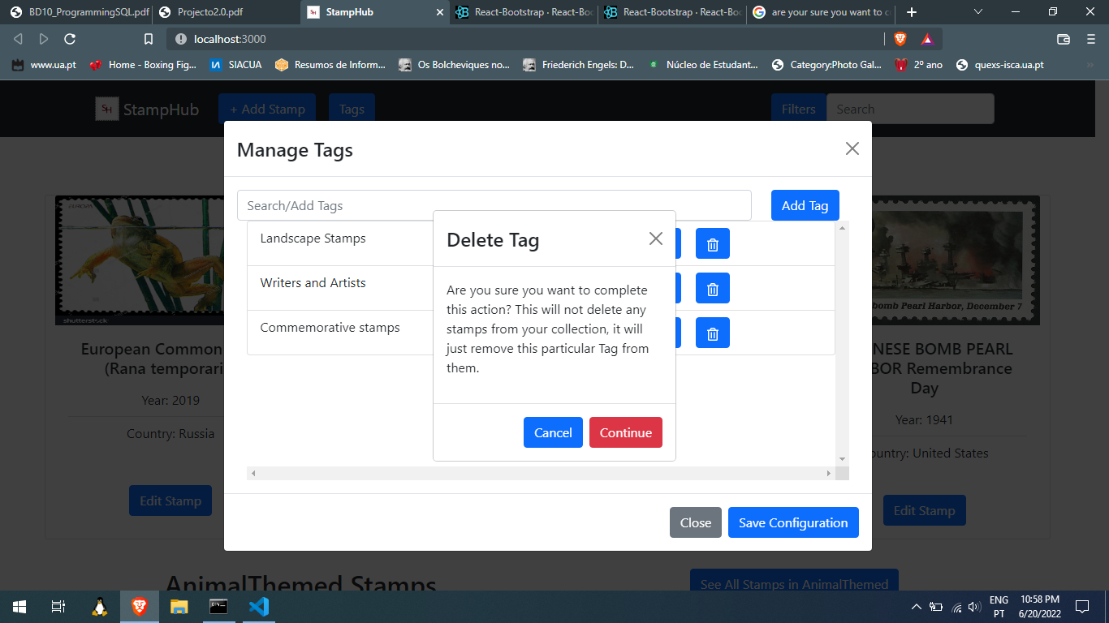
What did we changed after the Usability Test?
When performing the usability test most people shared their concerns for the lack of feedback when performing every task. So we decided to fix it!

Slide 15
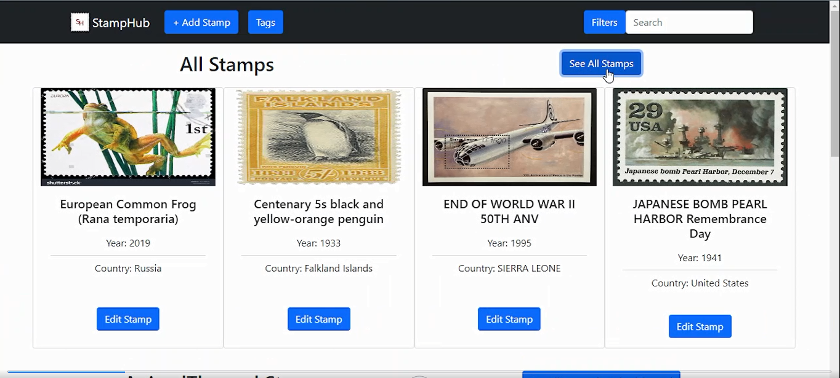
What did we changed after the Usability Test?
Some People mention the ability to see all Stamps in our collection would be very useful to add at the Opening View.
With that feedback in mind we made
a view that allows viewing of all
Stamps in our collection.

Slide 16
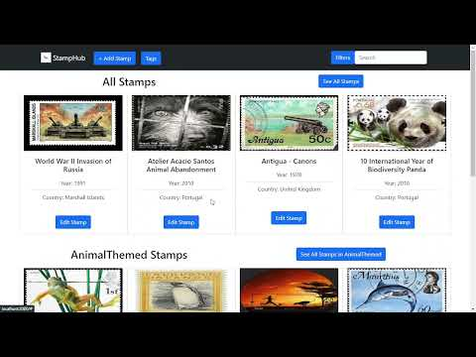

Slide 17
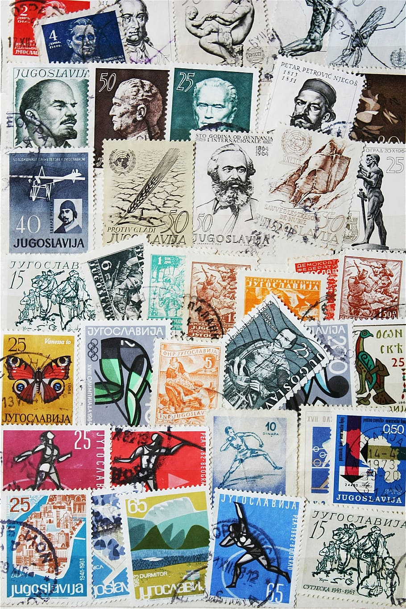
Future Work
If we decided to pursue this work these were the things we would like to implement:
Create a section where the user can write down the stamps they want to add to their collection.
The ability to follow another user’s collection.
A chat where different users can talk, this might be useful for trade or sell stamps.
Generate stats about the user’s collection using the tags. (What’s the percentage of portuguese stamps?)

